Slide 1
Control Flows

Slide 2
Why do we need control flow?

Slide 3
Why do we need control flow?
🚦 A traffic light checks conditions: red → stop, green → go, yellow → slow down. Your Python code does the same thing!
🎮 Game
🏦 Banking
🌤️ Weather App
Is health > 0?
Is balance enough?
Is temp < 10°C?
→ Keep playing
→ Allow transfer
→ Show coat icon
→ Game over
→ Decline
→ Show sun icon

Slide 4
What is control flow?

Slide 5
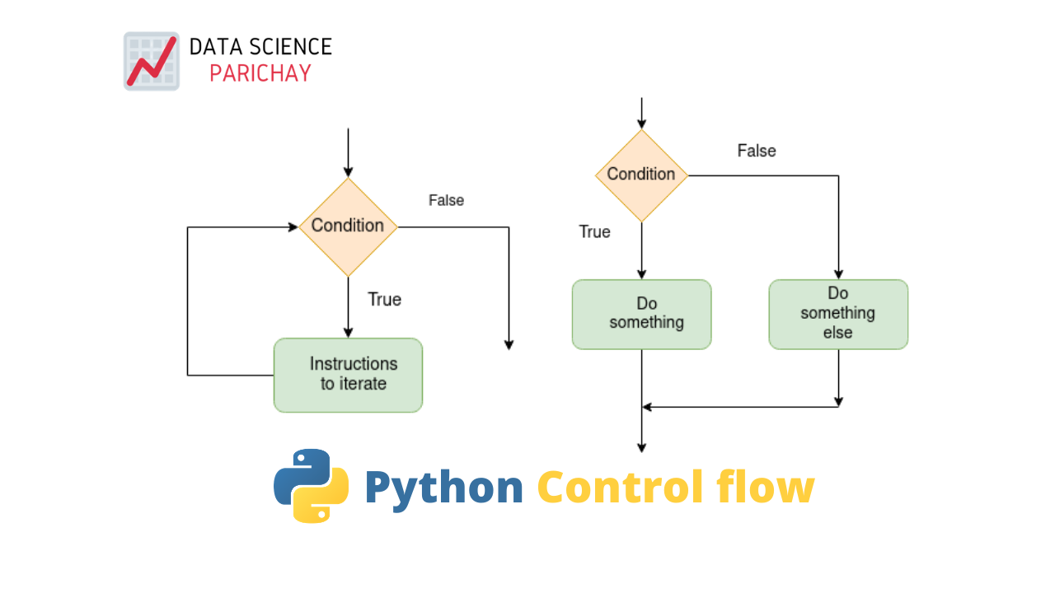
What is control flow?
Control flow structures allow you to dictate the order in which statements execute in your program.
Python manages control flow using 2 core structures
1
Conditional Statements
if / elif / else — branch based on True/False checks.
2
Loop & Transfer Statements
Repeat code and control iteration (covered in a later lesson).

Slide 6
Conditional Statements in control flow

Slide 7
Control Flows: The `if` Statement

Slide 8
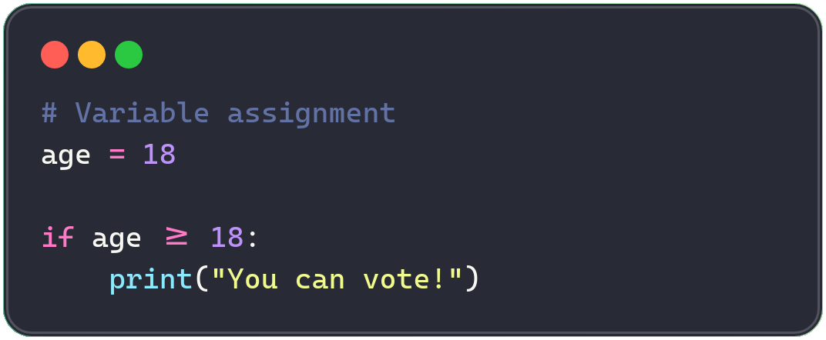
Control Flows: The `if` Statement
Code Sample
”If” statements let us control the order code runs in, based on conditions.
if keyword — starts the decision check
condition — an expression that is True or False
: colon — REQUIRED at the end of the line
indented block — only runs if condition is True

Slide 9
Control flow: `else` Statement - A Backup Plan

Slide 10
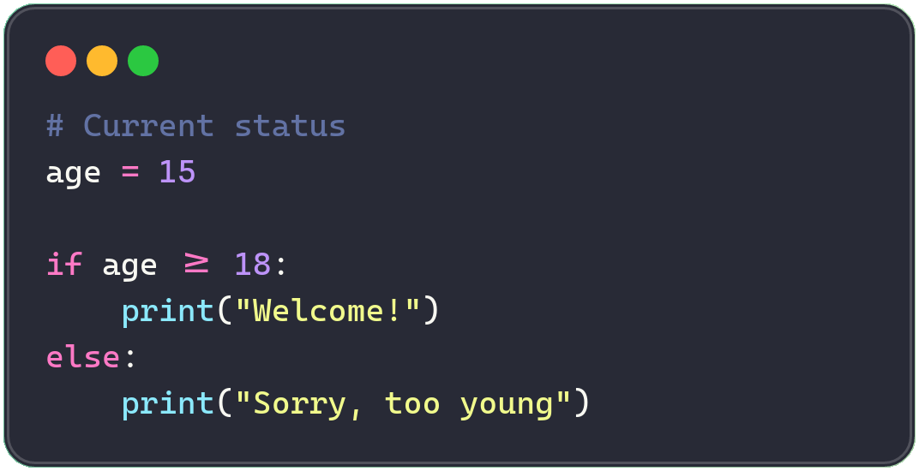
Control flow: `else` Statement - A Backup Plan
Code Sample
Program to check age:
age >= 18?
TRUE
FALSE
"Welcome!"
"Too young"
OUTPUT (age = 15)
▶ Sorry, too young 🚫
Challenge: change age to 20 and re-run — what happens to the output?
Code visualizer:
https://programiz.pro/code-visualizer/python
https://pythontutor.com/visualize.html#mode=display
https://learn-code-with-vengleab.vercel.app/
Notes:
age = 15
if age >= 18:
print("Welcome")
else:
print("Sorry, too young")

Slide 11
Control flow: `elif` Handles Multiple Scenarios

Slide 12
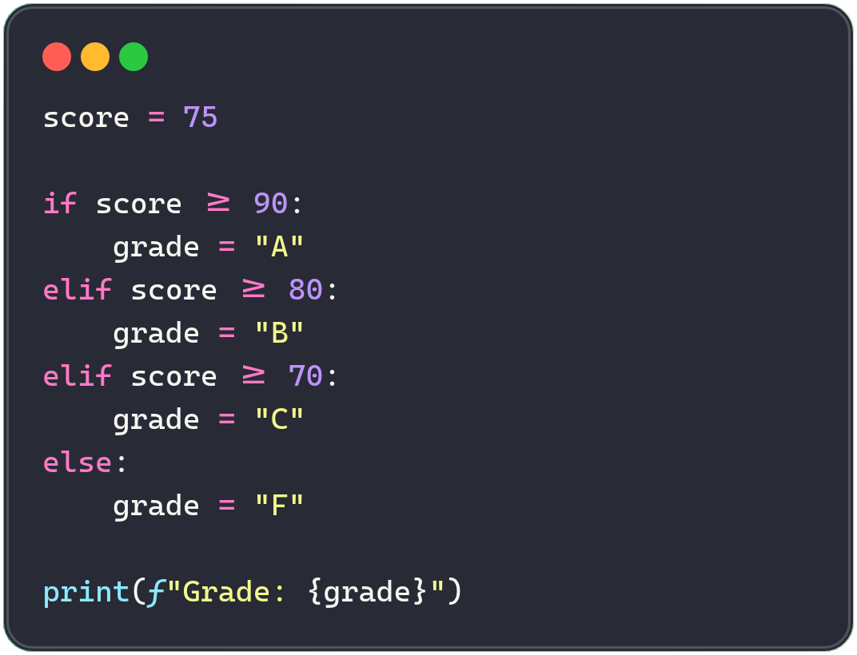
Control flow: `elif` Handles Multiple Scenarios
Code Sample
Grading app:
score >= 90 ? → A — Excellent
score >= 80 ? → B — Good
score >= 70 ? → C — Pass
else (catch-all) → F — Fail
Insight: Python checks conditions top-to-bottom and stops at the FIRST match.
Notes:
score = 75
if score >= 90:
grade = "A"
elif score >= 80:
grade = "B"
elif score >= 70:
grade = "C"
else:
grade = "F"
print(f"Grade: {grade}")

Slide 13
Visualize code execution

Slide 14
Test your knowledge

Slide 15
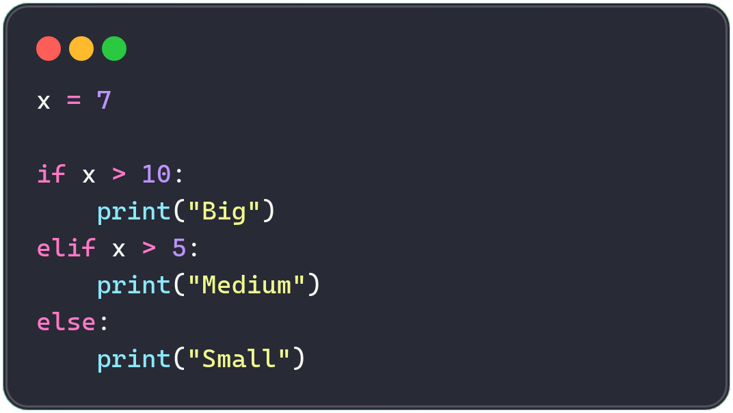
🧠 KNOWLEDGE CHECK
What Does This Code Print?
A) Big
B) Medium
C) Small
D) Nothing — syntax error
10

Slide 16
🧠 KNOWLEDGE CHECK
What Does This Code Print?
A) Big
B) Medium
C) Small
D) Nothing — syntax error
Insight: Answer: B) Medium — x is 7, which is > 5 but NOT > 10, so elif matches first.
10

Slide 17
Nested if Statements

Slide 18
`Nested if` Statements Go Deeper Into Decisions
Code Example for login check
INDENTATION = NESTING LEVEL
Level 0 — outer if
Level 1 — inner if
Level 2 — inner else
Insight: avoid nesting more than 2–3 levels deep. Consider combining conditions with and / or instead.

Slide 19
Ternary Expressions

Slide 20
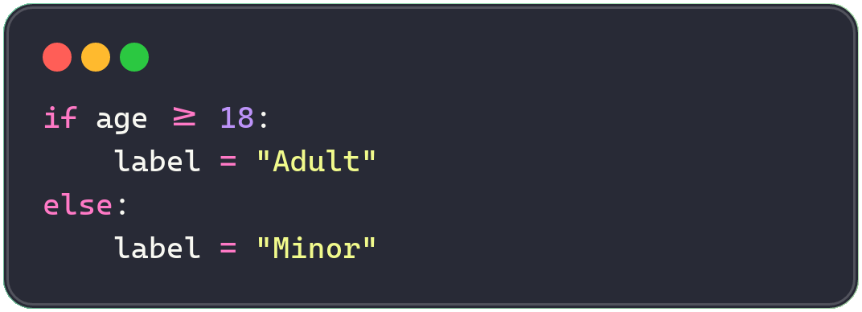
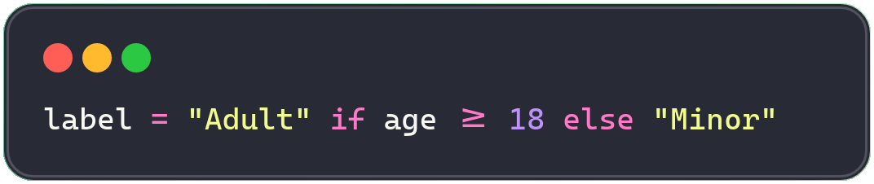
Ternary Expressions: Simple If-else Into One Line
😵 Before (4 lines)
😎 After (1 line)
→
ANATOMY OF Ternary Expressions
value_if_true if condition else value_if_false
Insight: use ternary for simple, readable assignments. For complex logic, stick with full if/elif/else.

Slide 21
Practices - Basic If-else

Slide 22
Positive Number & Even Number
TRY IT YOURSELF · LEVEL 1 · EXERCISES 1–2
1
Positive Number
2
Even Number
• Ask user to input a number
• If positive, print `Positive`
• Ask user to input an integer
• If even, print `Even`
ex01.py
ex02.py
number = float(input("Enter a number: "))
# TODO: check if number is positive
num = int(input("Enter an integer: "))
# TODO: use % to check even
Expected output:
[1] number: 10 → Output: Positive
[2] number: -10 → Output:
Expected output:
[1] num=10 → Output: even
[2] num= 9 → Output:

Slide 23
Adult Check & Pass or Fail
TRY IT YOURSELF · LEVEL 1 · EXERCISES 3–4
3
Adult Check
4
Pass or Fail
• Input age
• 18+ -> `Adult` else `Minor`
• Input score
• >= 50 -> `Pass`, else `Fail`
ex03.py
ex04.py
age = int(input("Enter age: "))
# TODO: compare age to 18
score = float(input("Enter score: "))
# TODO: compare score to 50
Expected output:
[1] age= 18 → Output: Adult
[2] age = 10 → Output: Minor
[3] age= 19 → Output: Adult
Expected output:
[1] score =10 → Output: Fail
[2] score = 50 → Output: Pass
[3] score = 100 → Output: Pass

Slide 24
Bigger Number & Temperature
TRY IT YOURSELF · LEVEL 1 · EXERCISES 5–6
5
Bigger Number
6
Temperature
• Ask user to Input two integers
• Print the larger one
• Ask user to Input temperature
• > 30 -> `Hot`, else `Cool`
ex05.py
ex06.py
a = int(input("First number: "))
b = int(input("Second number: "))
# TODO: compare a and b
temp = float(input("Enter temperature: "))
# TODO: compare temp to 30
Expected output:
[1] a = 20, b = 20 → Output:
[2] a = 20, b = 10 → Output: 20
[3] a = 18, b = 19 → Output: 19
Expected output:
[1] temp =10 → Output: Cool
[2] temp = 30 → Output: Cool
[3] temp= 100 → Output: Hot

Slide 25
Divisible by 5 & Username Check
TRY IT YOURSELF · LEVEL 1 · EXERCISES 7–8
7
Divisible by 5
8
Username Check
• Ask user to input a number
• Divisible by 5 -> `Yes`, else `No`
• Ask user to input a username
• `admin` -> `Welcome Admin`, else `Access Denied`
ex07.py
ex08.py
num = int(input("Enter a number: "))
# TODO: use % 5
username = input("Enter username: ")
# TODO: compare to "admin"
Expected output:
[1] num = 5 → Output: Yes
[2] num = 10 → Output: Yes
[3] num = 14 → Output: No
Expected output:
[1] username = admin → Output: Welcome Admin
[2] username = Admin → Output: Access Denied
[3] username = 100 → Output: Hot

Slide 26
Practices - Tenerary

Slide 27
Ternary: Maximum & Ternary: Even/Odd
TRY IT YOURSELF · LEVEL 1 · EXERCISES 9–10
9
Ternary: Maximum
10
Ternary: Even/Odd
ex09.py
ex10.py
a = int(input("First: "))
b = int(input("Second: "))
# TODO: one-line ternary
result = ... # a if ... else b
num = int(input("Enter integer: "))
# TODO: ternary -> "Even" or "Odd"
• Use only a ternary operator
• Print the larger number
• Use a ternary operator
• Print `Even` or `Odd`

Slide 28
Practices - Banking and Shopping related

Slide 29
Low Balance Warning & Withdrawal Check
TRY IT YOURSELF · BANKING · EXERCISES 1-2
1
Low Balance Warning
2
Withdrawal Check
• Ask user to input balance and threshold
• If balance is below threshold, print `Low balance warning`
• Ask user to input balance and withdrawal
• If withdrawal <= balance print `Approved`, else `Insufficient funds`
ex01.py
ex02.py
balance = float(input("Enter balance: "))
threshold = float(input("Enter threshold: "))
# TODO: print a warning if balance is below threshold
balance = float(input("Enter balance: "))
withdrawal = float(input("Enter withdrawal: "))
# TODO: print Approved or Insufficient funds
Expected output:
[1] balance=45, threshold=100 → Output: Low balance warning
[2] balance=150, threshold=100 → Output: (nothing)
Expected output:
[1] balance=200, withdrawal=250 → Output: Insufficient funds
[2] balance=200, withdrawal=150 → Output: Approved

Slide 30
Account Tier & Transfer Verification
TRY IT YOURSELF · BANKING · EXERCISES 3-4
3
Account Tier
4
Transfer Verification
• Ask user to input balance
• Print the matching tier: Platinum >=10000, Gold >=5000, Silver >=1000, else Basic
• First check if account is verified
• If verified, check amount against the daily limit
ex03.py
ex04.py
balance = float(input("Enter balance: "))
# TODO: classify into Platinum / Gold / Silver / Basic
verified = input("Verified? (yes/no): ") == "yes"
amount = float(input("Enter amount: "))
daily_limit = 5000
# TODO: nested check: verified, then within daily limit
Expected output:
[1] balance=7500 → Output: Gold
[2] balance=800 → Output: Basic
Expected output:
[1] verified=yes, amount=6000 → Output: Flagged for review
[2] verified=no, amount=3000 → Output: Account not verified

Slide 31
Free Shipping & Promo Code
TRY IT YOURSELF · SHOPPING · EXERCISES 1-2
5
Free Shipping
6
Promo Code
• Ask user to input cart total
• If $50 or more, print `You qualify for free shipping!`
• Ask user to input code and price
• Apply 10% discount only if code equals `SAVE10`
ex09.py
ex10.py
cart_total = float(input("Enter cart total: "))
# TODO: check if total qualifies for free shipping
code = input("Enter promo code: ")
price = float(input("Enter price: "))
# TODO: apply 10% off if code == SAVE10
Expected output:
[1] code=SAVE10, price=80 → Output: 72.0
[2] code=X, price=80 → Output: 80
Expected output:
[1] cart_total=62 → Output: free shipping!
[2] cart_total=30 → Output: (nothing)

Slide 32
Discount Tiers & Membership Discount
TRY IT YOURSELF · SHOPPING · EXERCISES 3-4
7
Discount Tiers
8
Membership Discount
• Ask user to input amount spent
• Print discount tier: 20% >=200, 10% >=100, 5% >=50, else none
• First check if customer is a member
• If member, check total against loyalty threshold ($100)
ex11.py
ex12.py
spent = float(input("Enter amount spent: "))
# TODO: print discount tier
is_member = input("Member? (yes/no): ") == "yes"
total = float(input("Enter total: "))
# TODO: nested check: member, then loyalty bonus
Expected output:
[1] spent=120 → Output: 10% off
[2] spent=40 → Output: No discount
Expected output:
[1] is_member=yes, total=150 → Output: loyalty discount
[2] is_member=no, total=200 → Output: No discount

